Slide 1
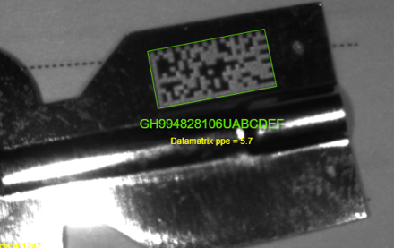
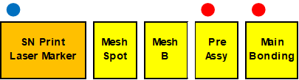
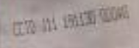
Traceability
➣Bonding Process
2D Code Print
2D Code Scanner
2D Code Print
Laser Marker
2D Code Print
(DataMatrix)
CV-X290F
Result AOI
Machine No.
Fixture No.
(Temperature)
➣Water Injection Process
Head No.
Result
Head No.
Result
Head No.
Result
2D Code Scan
SN Print (Ink Jet)
SN Print
Ink Jet Printer
Head No.
Irradiation time
Head No.
Vacuum pressure
Water temperature
Head No.
Result
➣Test Process
Result
Head No.
Result
NG outflow prevention
Notes:
Heat sink and cosmetic/mechanical parts are manufactured at Dongguan supplier. Those two items are 28% of contribution to our sales revenue.

Slide 2
Weight check
Setup Schedule: until 23-Dec
Software make up: until 17-Dec
PQM
Upload by Http
Upload by Http
Data download from DB
PLC
Scanner
PC
Scanner(LAN)
Fixed on balancer
Weight (1)
Weight (3)
Download data
Upload data
Judgement: only WATER_WEIGHT_AFTER_VACUUM
Notes:
Heat sink and cosmetic/mechanical parts are manufactured at Dongguan supplier. Those two items are 28% of contribution to our sales revenue.

Slide 3
Weight check
PQM
Basic scheme.
Put a VC on balancer.
Scan the SN.
PC get the SN from scanner.
Start communicate the Before weight from PQM.
Getting the weight value from Balancer behind the 4 second from get SN.
Calculate the value and display the Judgement.
Upload the result for PQM.
Structure
Scanner
LAN
LAN
Balancer
PC
RS232C
Please settable the value for following parameters.
Upper limit (when a value is just same as limit, judgement is OK)
Lower limit (when a value is just same as limit, judgement is OK)
Waiting time from get SN to get weight value.
Mode, Site, Factory, Line, Process, and Machine code.
Communication setting and other parameters should be changeable.
Please display the Judgement on screen (1st step)
Notes:
Heat sink and cosmetic/mechanical parts are manufactured at Dongguan supplier. Those two items are 28% of contribution to our sales revenue.

